Slide 1

Slice Demand
Sprint 1
Samuel Ferrer

Slide 2

Problem Statement:
How can we reduce waste based on historical data of the restaurant to increase or maximize profits?

Slide 3
Proposed Solution & Impact
Proposal:
With machine learning, especially time series models, restaurant owners can predict the demand for items on their menus using their historical data.
Restaurant owners would maximize their profits by reducing the cost of un-consumed or unused products.
It gives restaurant owners an understanding of the demand for their products and how it can vary over time.
A time series model could also help restaurant owners prepare for each item on their menu and use that to their advantage to drive the sale of items.
Notes:
If restaurant owners would like to expand within the food and beverage realm within hospitality they can use this model to plan and ensure they can start making profits.

Slide 4
Data Dictionary
Column Name | Description | Data Type
Date | Date associated to each column | datetime64
Sold (Qty) | Total slices sold | int64
Produced (Qty) | Total slices produced | int64
Waste (%) | Percentage of slices wasted | float64
Waste (Qty) | Total slices wasted | int64
Temperature (Avg.) | Average temperature of the day | float64
Revenue/ Profit | Total Profit of slices | int64
Flavor | Flavors of the slices | object
Rain? | Binary column showing whether it rained or not that day | int64

Slide 5
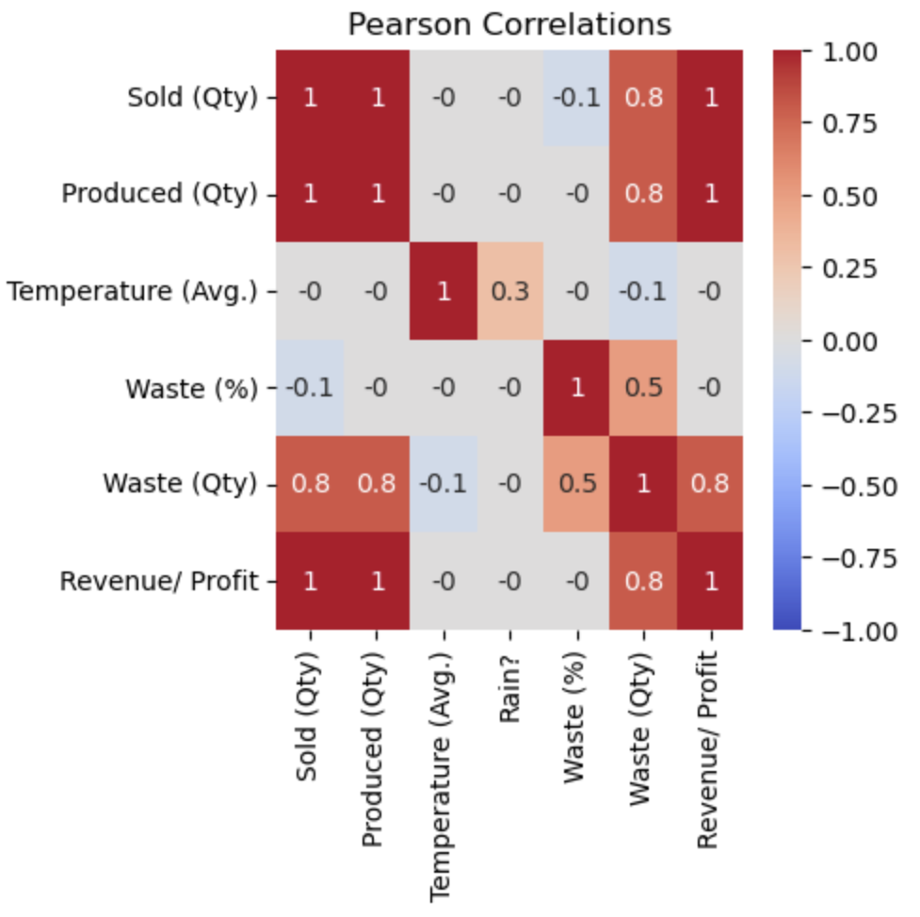
Exploratory Data Analysis
There seems to be a strong and positive correlation between the following columns:
Sold (Qty)
Produced(Qty)
Waste(Qty)
Revenue/ Profit

Slide 6
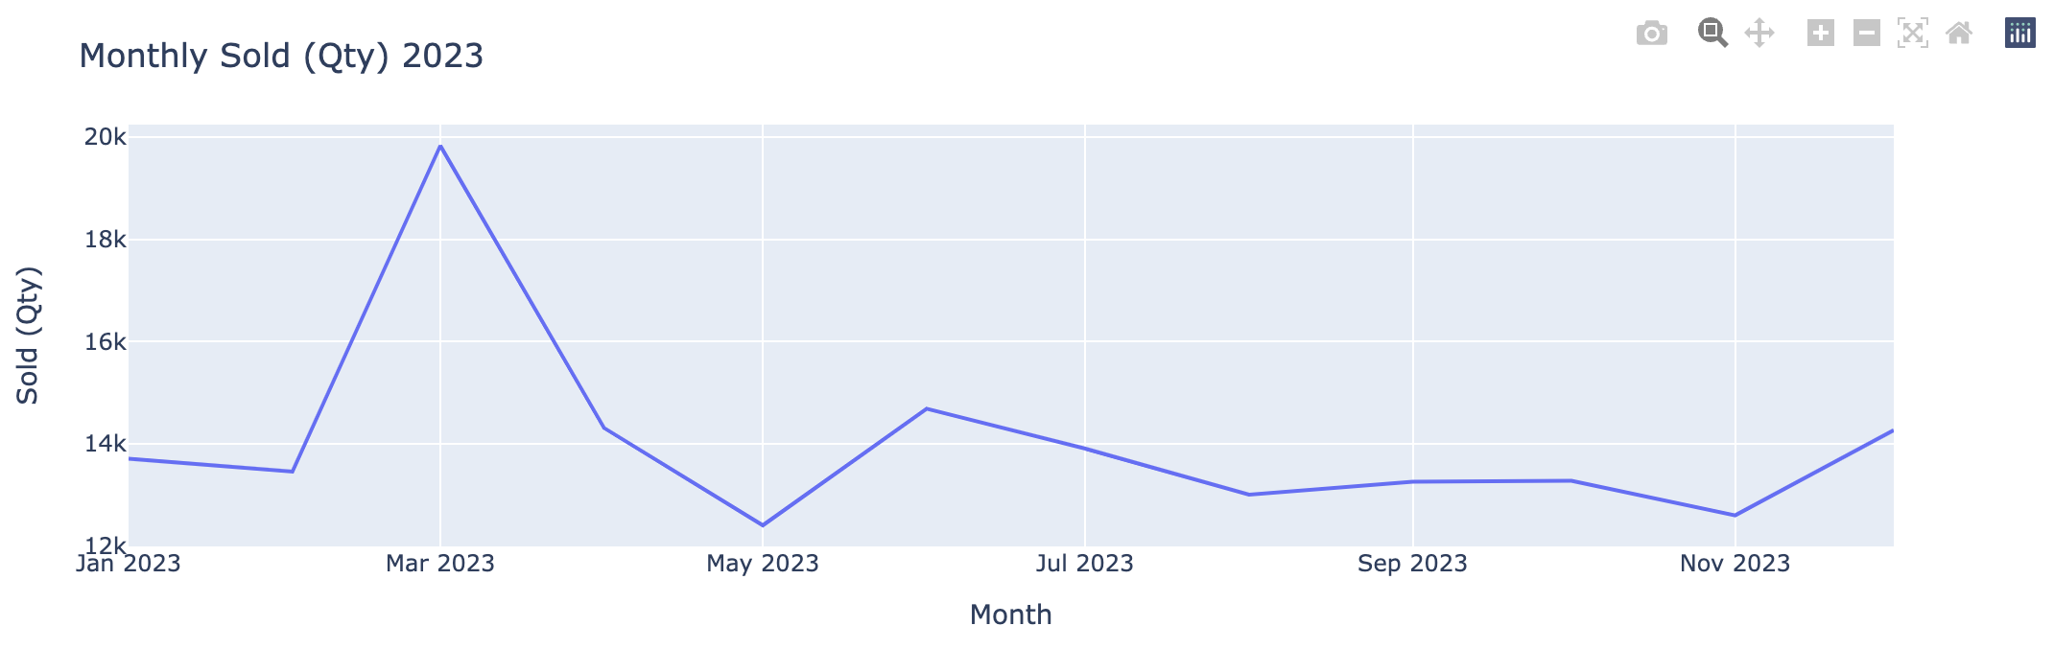
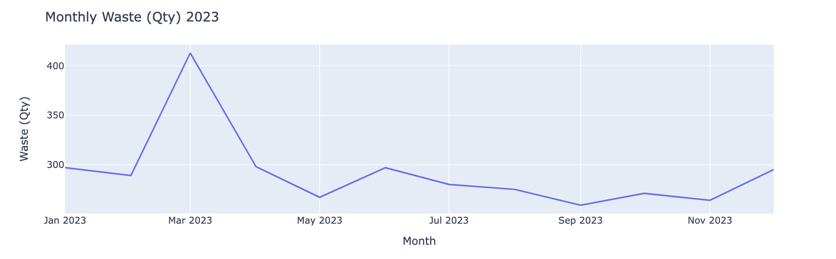
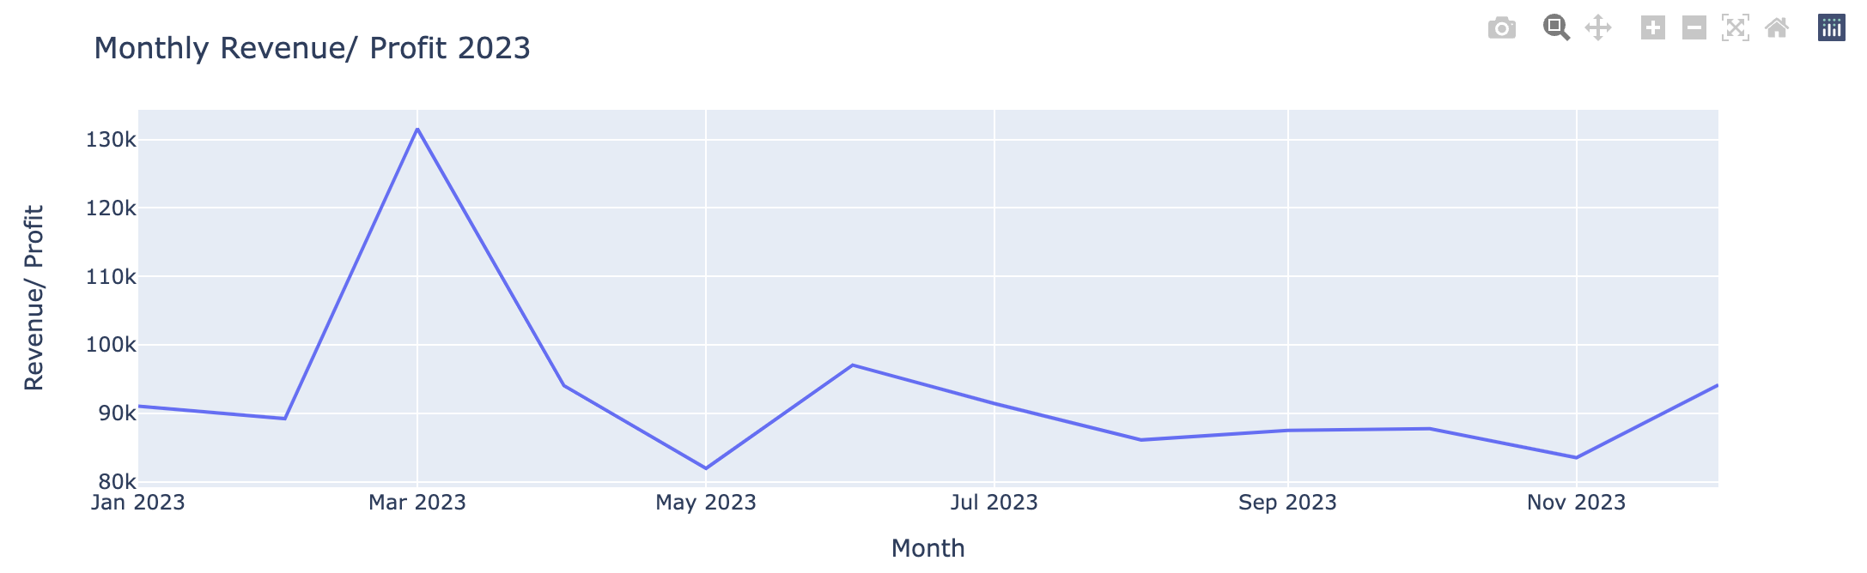
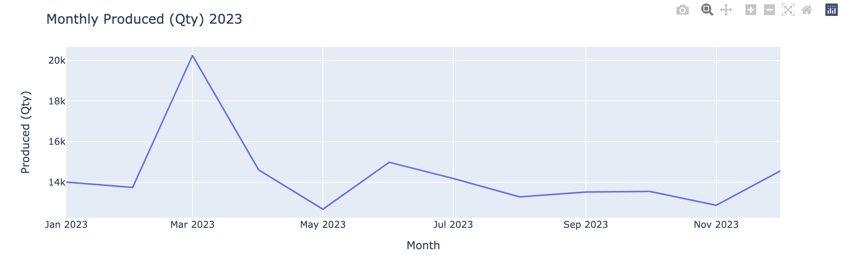
Exploratory Data Analysis (Cont.)
The graphs showcase the Monthly distribution of the following columns:
Sold (Qty)
Waste (Qty)
Revenue/ Profit
Produced (Qty)
They indicate a seasonality component through changes on a month-to-month basis.
Another thing to point out is that the visualizations highlight the problem.

Slide 7
Next Steps
Potentially encoding the different flavors within the data set.
Explore feature engineering to create a column associated with the seasonality of sales.
Explore different Time Series models to understand which one works best in terms of our proposed solution.

